Slide 1
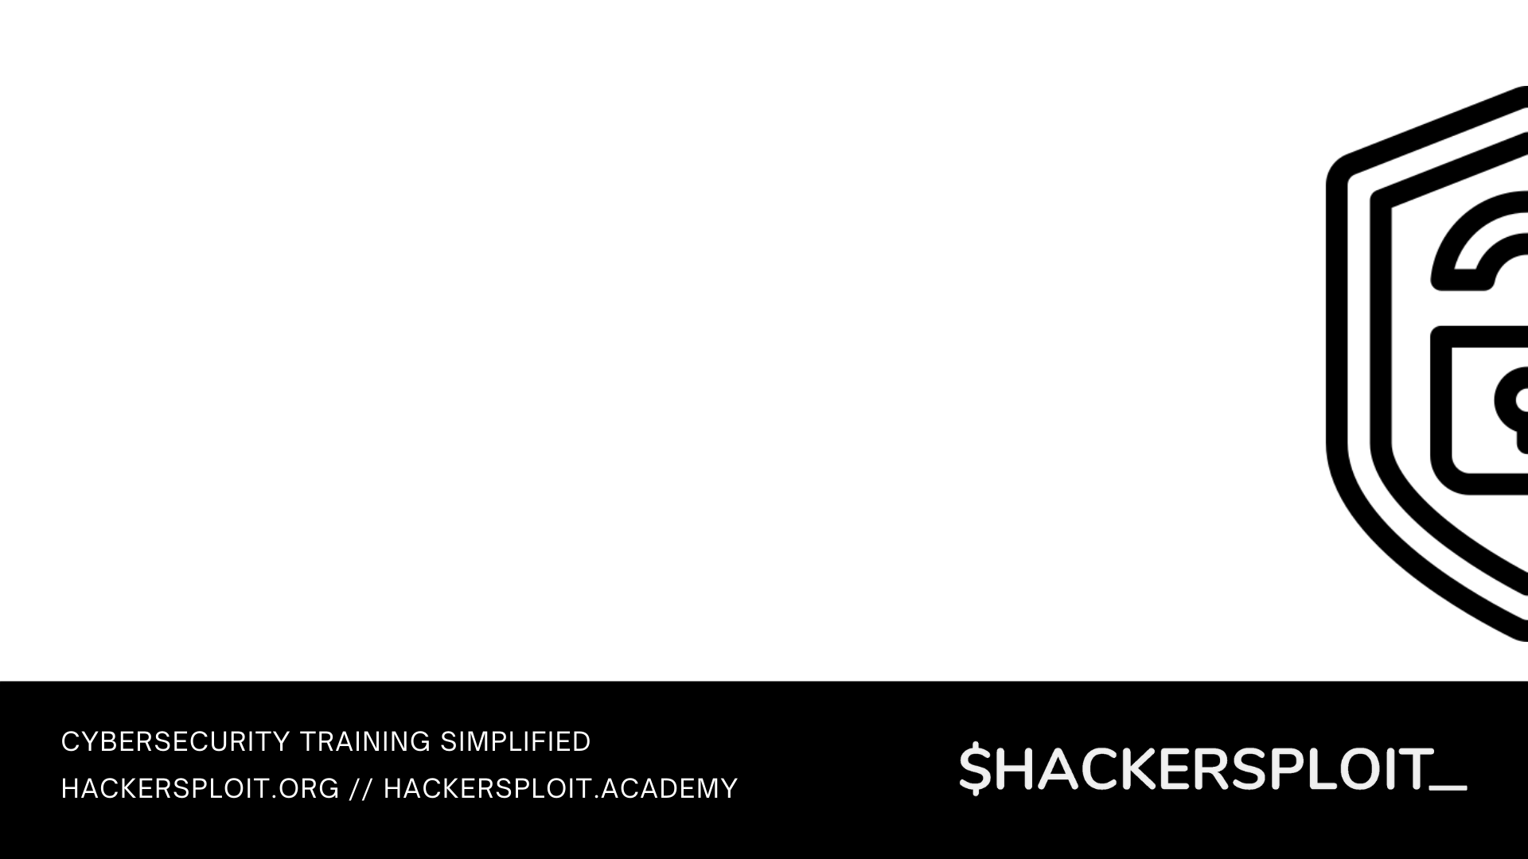

Blue Team Training Series
Introductory guide to blue team operations

Slide 2


Intrusion Detection With Snort
Detecting network intrusions with snort

Slide 3

What we will be covering
Intrusion detection systems
Introduction to Snort
How Snort works
Snort network placement
Installing & configuring Snort
Snort configuration file
Writing custom Snort rules

Slide 4
Prerequisites
Familiarity with information security concepts.
Familiarity with Linux and various command line utilities.
A good understanding of the OSI model and the layers that make up the model.
Functional knowledge of TCP/IP & UDP.
Familiarity with HTTP & Web technologies.

Slide 5
Intrusion Detection Systems (IDS)
Intrusion detection is the process of actively discovering threats/attacks/intrusions on a network, hosts or services.
There are 2 types of IDS solutions based on the placement, a host-based IDS (HIDS) is setup on an individual host on a network and a network IDS (NIDS) is placed within a network to monitor traffic to and from all hosts on a network.
An IDS is a system/host planted within a network to capture traffic and identify malicious activity based on predefined rules, after which, this malicious activity is logged, and a notification is sent to the relevant parties informing them of an intrusion.
Intrusion detection systems are typically coupled with the functionality to also perform intrusion prevention, whereby specific rules can be set to drop packets that are malicious or intrusive.

Slide 6
Introduction to Snort
Snort is a popular free and open-source IDS/IPS system that is used to perform traffic/protocol analysis, content matching and can be used to detect and prevent various attacks based on predefined rules.
Snort has been active development and has thousands of users and contributors that develop rules to keep Snort up to date with the latest attacks.
Snort has 3 main operational modes
Packet Sniffing – Collects and displays network traffic like what Wireshark does.
Packet Logging - Collects and logs network traffic into a file.
Network intrusion detection – Analyzes packets and matches traffic against signatures

Slide 7
Introduction to Snort
Snort detects malicious traffic or attacks by leveraging pattern matching.
When active, Snort captures packets, reassembles them, analyzes them and determines what needs to be done to the packet based on predefined rules.
Snort rules are very similar to a typical firewall rule, whereby, they are used to match network activity against specific patterns or signatures and consequently make a decision as to whether to send an alert or drop the traffic (in the case of IPS).
Snort has a large amount or rule-sets created by the community that are very useful to begin with.

Slide 8
Snort versions
Snort was initially developed in 1998 and has been continuously improved since then.
There are currently 2 versions of Snort available:
Snort 2.X - De facto version of snort.
Snort 3.0 – Latest version of Snort that features improved efficiency, performance, scalability and usability over Snort 2.
In this video, we will be using Snort 2.x as it is the most widely implemented version and has extensive support, documentation & rule-sets.
Note: Rules written for Snort 2 will need to be re-written or converted to the new Snort 3 format.

Slide 9
Snort rules
Snort has 3 types of rules/rule-sets:
Community rules - Free rule-sets created by the Snort community.
Registered rules – Free rule-sets created by Talos. In order to use them, you must register for an account.
Subscription only rules – These rule-sets require an active paid subscription in order to be accessed and used.
Or… we can write our own rules based on your requirements.

Slide 10
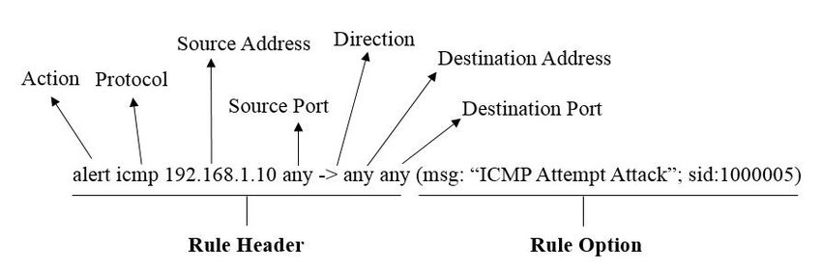
Snort rule syntax

Slide 11
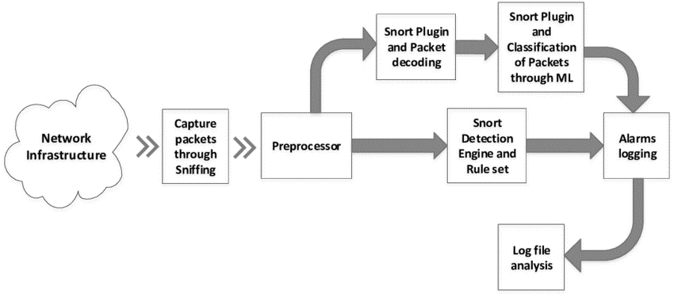
How Snort works

Slide 12
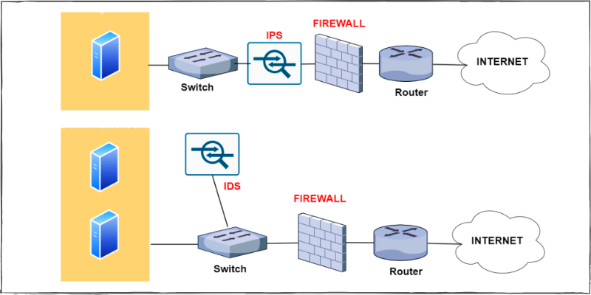
Snort IDS network placement

Slide 13
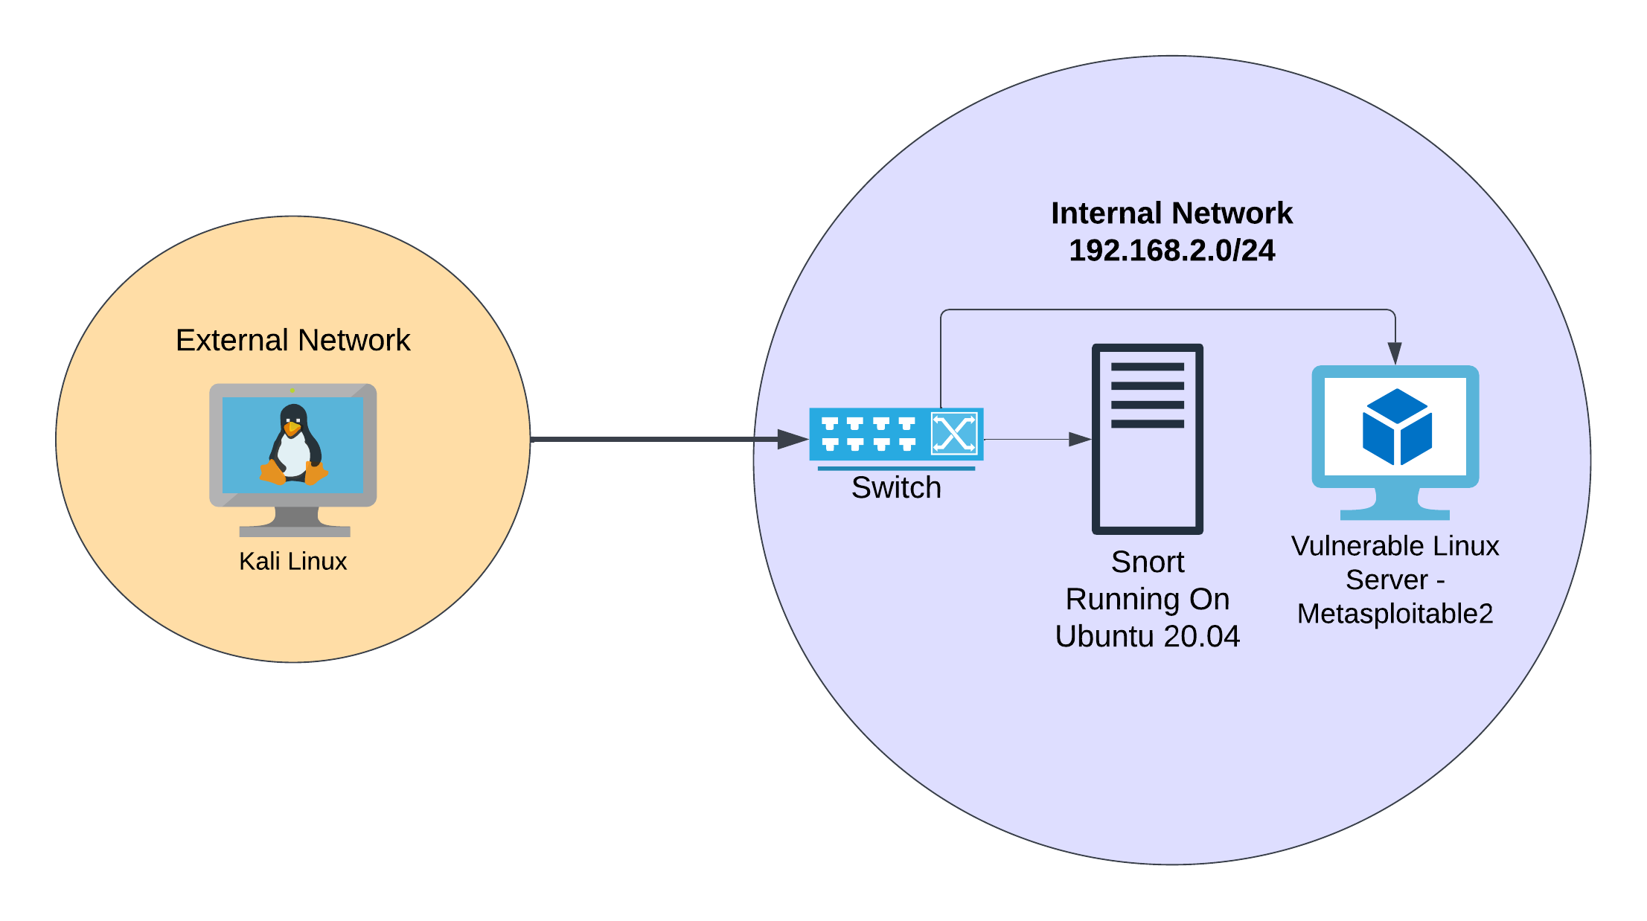
Lab environment

Slide 14
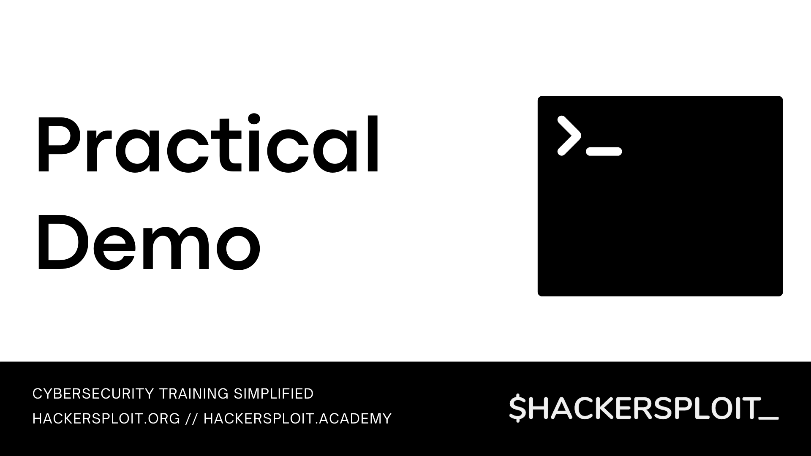

Slide 15


Slide 16


Threat Detection With Wazuh
Next up

